Slide 1
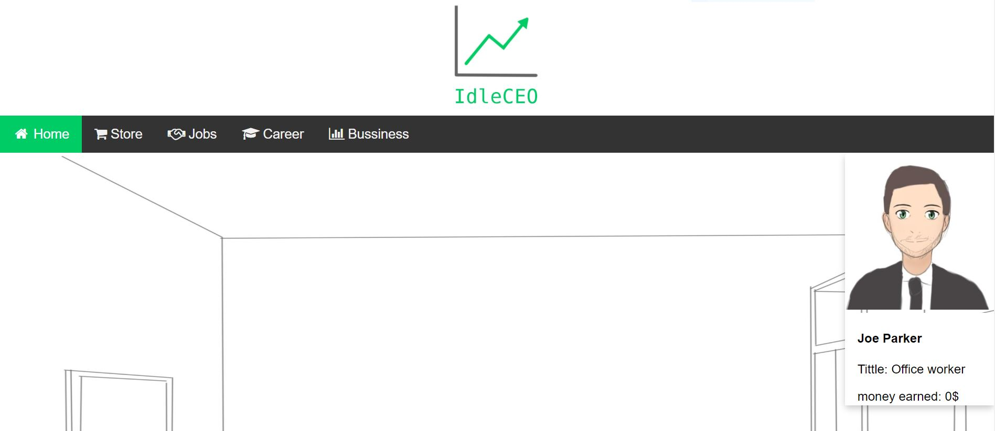
Johan Nguyen
Frogmaster studio
IdleCEO
Concept: Incremental web game.
Genre: business/management, incremental web game. Free to Play.
X statement: click to earn money.
Description: collect bottles, start your own business to generate passive income and become a CEO.
Key Features:
Web game, easy access
Graphics minimal, don’t need good PC
Casual, easy to play
Audience: Incremental gamers
Competitive analysis: AdVenture Capitalist, Startup Company, game-play is unique
The Ask: 100k for the first playable demo.
The Return: 1% of total market 1.0million.
Copyright Frogmaster studio 2020.

